Slide 1

Persil Caps Promotion Concept 1ST
Redwood Interactive
2013.03.29
ⓒ 2013 redwood marketing services. ALL RIGHTS RESERVED

Slide 2
Persil Caps Promotion Concept
Concept : This or That
Platform : Facebook(PC, Mobile)
Prize :
Function : Fan Gate, This or That, Entry Form, Wall Post
Campaign process :
Weekly
Fan Gate
Intro
This or That
Entry Form
Video View
ⓒ 2013 redwood marketing services. ALL RIGHTS RESERVED

Slide 3
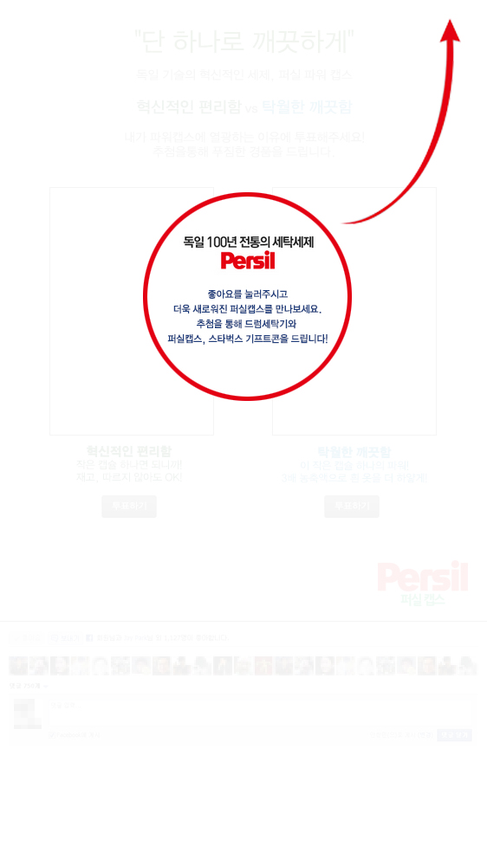
PAGE 1. FANGATE
Persil Caps Promotion Concept
1
No | Assigned Action
1 | Click ‘like’ to enter event➔ Page 2
ⓒ 2013 redwood marketing services. ALL RIGHTS RESERVED

Slide 4
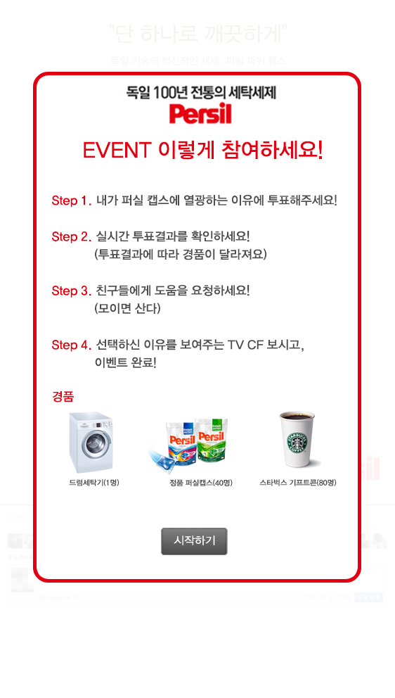
PAGE 2. INTRO
Persil Caps Promotion Concept
1
2
No | Assigned Action
1 | Read event flow and instructions on Intro Page
2 | Click ‘Event Start’ button➔ Page 3
ⓒ 2013 redwood marketing services. ALL RIGHTS RESERVED

Slide 5
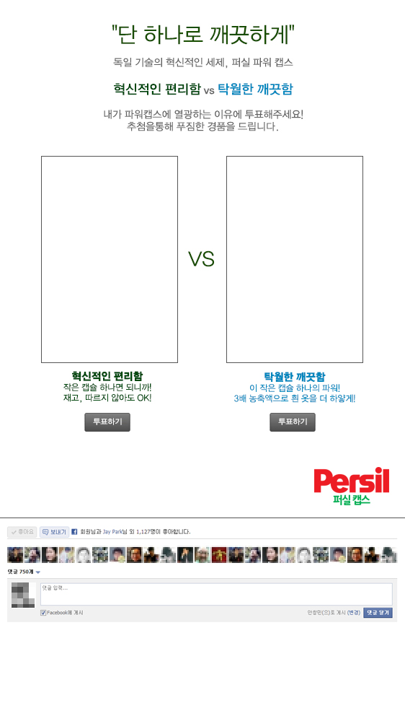
PAGE 3. MAIN PAGE
Persil Caps Promotion Concept
관련 이미지 -1
관련 이미지 -2
1
2
# Need users to be divided in DB according to who they vote for
(This will be used to link users to separate end pages displaying different videos)
3
4
No | Assigned Action
1 | User likes image 1➔ selects image 1 button➔ Page 4
2 | User likes image 2➔ selects image 2 button➔ Page 4
3 | Display users who ‘like’ this page (eg on ESPN or Grantland)
4 | Functionality to leave a comment
ⓒ 2013 redwood marketing services. ALL RIGHTS RESERVED

Slide 6
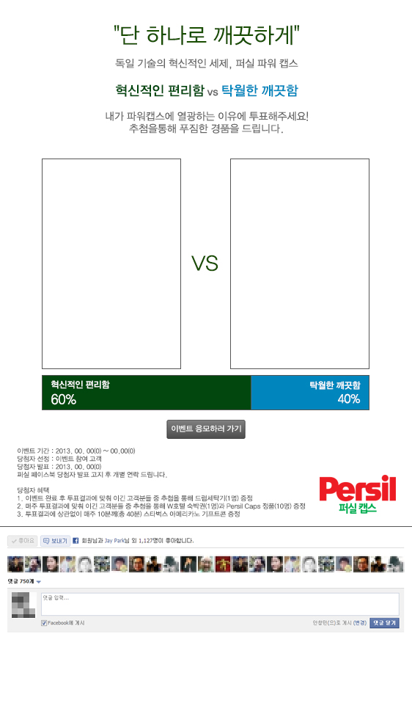
PAGE 4. MAIN PAGE
Persil Caps Promotion Concept
관련 이미지 -1
관련 이미지 -2
1
3
2
#Vote results need to update in real-time to promote sharing.
#Only winners in vote will be eligible for grand prizes.
No | Assigned Action
1 | Real-time voting display
2 | Go to sharing➔ Page 5
3 | Event details
ⓒ 2013 redwood marketing services. ALL RIGHTS RESERVED

Slide 7
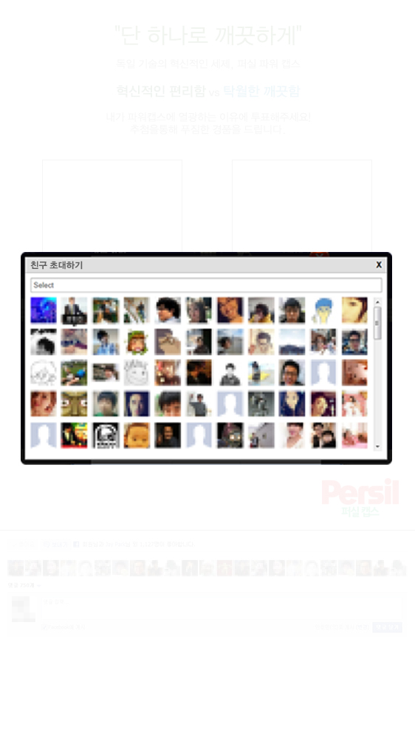
PAGE 5. SUB PAGE
Persil Caps Promotion Concept
1
2
# according to Facebook rules, can only post to one friend’s wall
No | Assigned Action
1 | Go back/cancel button➔ Page 4
2 | Select friend and share➔ Page 6
ⓒ 2013 redwood marketing services. ALL RIGHTS RESERVED

Slide 8
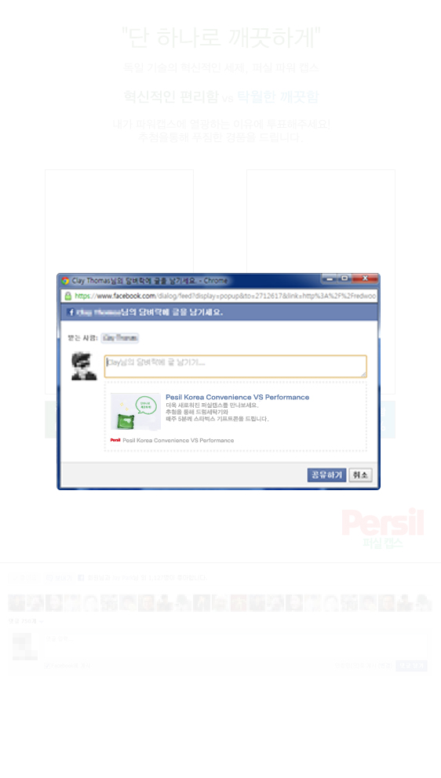
PAGE 6. SUB PAGE
Persil Caps Promotion Concept
1
2
3
4
# 공유하기 기능 사용에 대한 사용자 선택 가능
No | Assigned Action
1 | Skip sharing/cancel➔ Page 7
2 | Enter a message to your friend
3 | Share to friend’s wall➔ Page 7
4 | Skip sharing/cancel➔ Page 7
ⓒ 2013 redwood marketing services. ALL RIGHTS RESERVED

Slide 9
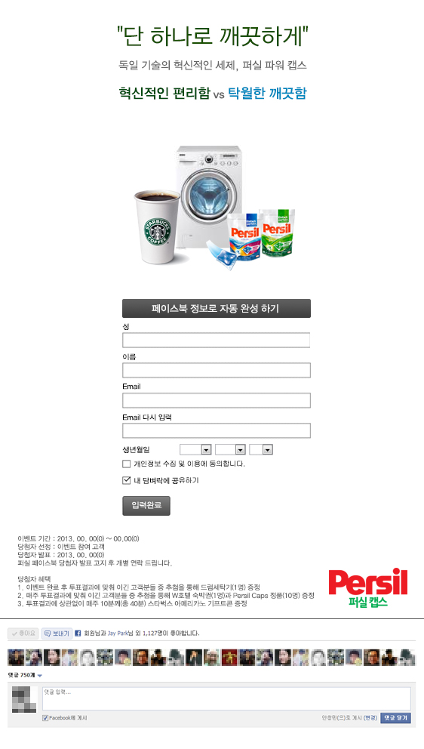
PAGE 7. ENTRY FORM
Persil Caps Promotion Concept
1
2
3
5
4
6
No | Assigned Action
1 | Images for sweepstakes prizes
2 | Fill in w/ facebook info automatically ➔ Action 3 Skip
3 | Fill in info form
4 | Agreeing to facebook rules and conditions checkbox
5 | ‘Share to my wall’ checkbox
6 | ‘Enter Sweepstakes’ button➔ Page 8
ⓒ 2013 redwood marketing services. ALL RIGHTS RESERVED

Slide 10
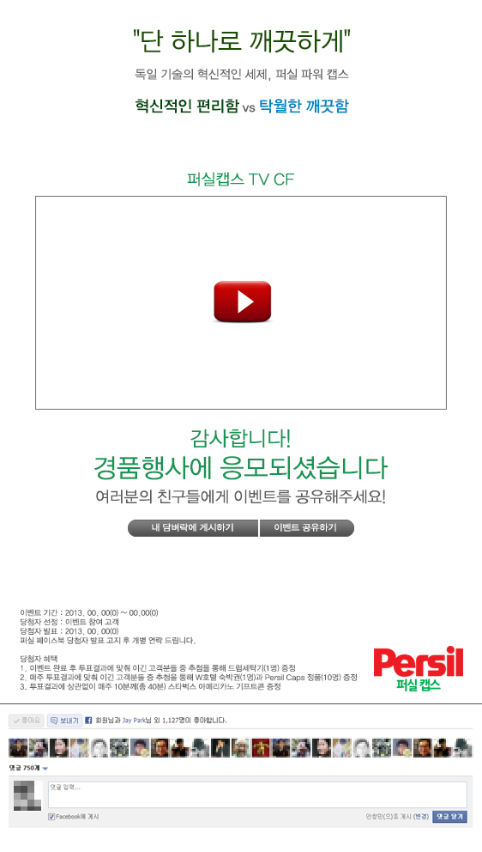
PAGE 8. END PAGE
Persil Caps Promotion Concept
1
2
3
4
No | Assigned Action
1 | Play video according to the image user selected on Page 5
2 | Display ‘Entry complete’ message
3 | ‘Post to my wall’ button➔ Page 8
4 | ‘Share Event’ ➔ Page 9
ⓒ 2013 redwood marketing services. ALL RIGHTS RESERVED

Slide 11
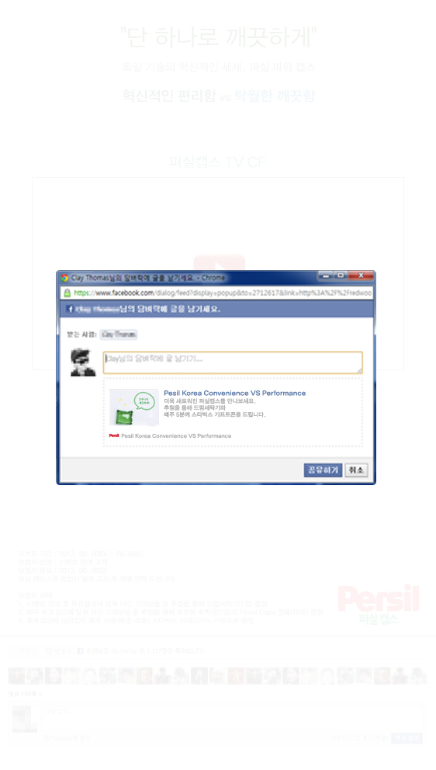
PAGE 9. SUB PAGE
Persil Caps Promotion Concept
1
2
3
4
# additional sharing option
No | Assigned Action
1 | Skip/cancel ➔ Page 9
2 | Message to friend field
3 | Share event ➔ Page 9
4 | Skip sharing/cancel➔ Page 9
ⓒ 2013 redwood marketing services. ALL RIGHTS RESERVED

Slide 12
Thank you
Redwood Interactive
ⓒ 2013 redwood marketing services. ALL RIGHTS RESERVED

